Slide 1
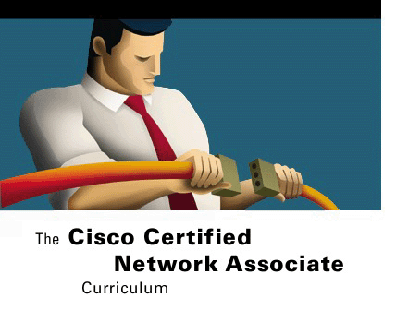
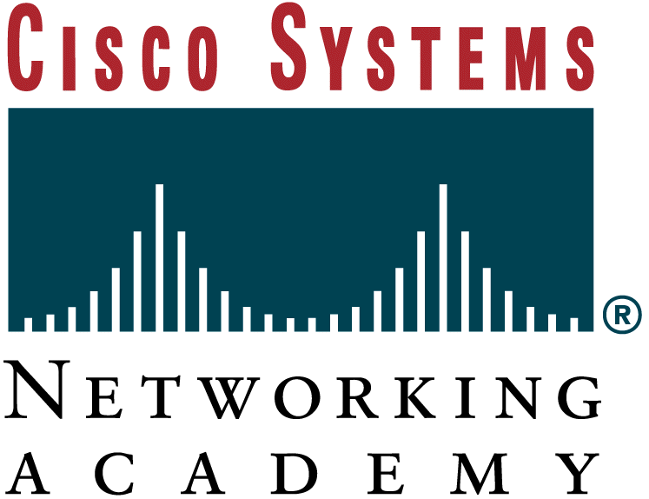


Single Area OSPF
Switching Basics and Intermediate Routing
Version 3.0
Cisco Regional Networking Academy

Slide 2
Objectives
Identify the key features of link-state routing
Explain how link-state routing information is maintained
Discuss the link-state routing algorithm
Examine the advantages and disadvantages of link-state routing
Compare and contrast link-state routing with distance vector routing
Enable OSPF on a router
Configure a loopback address to set router priority
Change OSPF route preference by modifying the cost metric
Notes:
Overview
The two main classes of interior gateway routing protocols (IGP) are distance vector and link-state. Both types of routing protocols are concerned with finding routes through autonomous systems. Distance vector and link-state routing protocols use different methods to accomplish the same tasks. Link-state routing algorithms, also known as shortest path first (SPF) algorithms, maintain a complex database of topology information. A link-state routing algorithm maintains full knowledge of distant routers and how they interconnect. In contrast, distance vector algorithms provide nonspecific information about distant networks and no knowledge of distant routers. Understanding the operation of link-state routing protocols is critical in understanding how to enable, verify, and troubleshoot their operation. This module explains how link-state routing protocols work, outlines their features, describes the algorithm they use, and points out the advantages and disadvantages of link-state routing.Early routing protocols like RIP were all distance vector protocols. Many of the important protocols in use today are also distance vector protocols, including RIP v2, IGRP, and EIGRP. However, as networks grew in size and complexity, some of the limitations of distance vector routing protocols became apparent. Routers in a network using a distance vector scheme could only guess at the network topology based on the full routing tables received from neighboring routers. Bandwidth usage is high because of periodic exchange of routing updates, and network convergence is slow resulting in poor routing decisions.Link-state routing protocols differ from distance vector protocols. Link-state protocols flood routing information allowing every router to have a complete view of the network topology. Triggered updates allow efficient use of bandwidth and faster convergence. Changes in the state of a link are sent to all routers in the network as soon as the change occurs.One of the most important link-state protocols is Open Shortest Path First (OSPF). OSPF is based on open standards, which means it can be developed and improved by multiple vendors. It is a complex protocol that is a challenge to implement in a large network. The basics of OSPF are covered in this module.OSPF configuration on a Cisco router is similar to the configuration of other routing protocols. As with other routing protocols, the OSPF routing process must be enabled and networks must be identified that will be announced by OSPF. However, OSPF has a number of features and configuration procedures that are unique. These features make OSPF a powerful choice for a routing protocol and make OSPF configuration a very challenging process.In complex large networks, OSPF can be configured to span many areas and several different area types. The ability to design and implement large OSPF networks begins with the ability to configure OSPF in a single area. This module also discusses the configuration of single area OSPF.

Slide 3
Objectives
Configure OSPF authentication
Change OSPF timers
Describe the steps to create and propagate a default route
Use show commands to verify OSPF operation
Configure the OSPF routing process
Define key OSPF terms
Describe the OSPF network types
Describe the OSPF Hello protocol
Identify the basics steps in the operation of OSPF

Slide 4
Table of Content
1 | Link-state Routing Protocol
2 | Single Area OSPF Concepts
3 | Single Area OSPF Configuration

Slide 5

LINK-STATE ROUTING PROTOCOL

Slide 6
Overview of link-state routing
Protocol | Description | Characteristics
Distance vector | RIP v1 and RIP v2 Interrior Gateway Routing Protocol (IGRP) | Copies routing table to neighbors Updates frequently Slow converge RIP v1 and RIP v2 use hop count as metric View network from neighbors’ perspective Susceptible to routing loops Easy to configure and administrate Consumes a lot of bandwidth
Notes:
Link-state routing protocols perform in a very different way from distance vector protocols. Understanding the difference between distance vector and link-state protocols is vital for network administrators. One essential difference is that distance vector protocols use a simpler method of exchanging routing information. Figure outlines the characteristics of both distance vector and link-state routing protocols.
Link-state routing algorithms maintain a complex database of topology information. While the distance vector algorithm has nonspecific information about distant networks and no knowledge of distant routers, a link-state routing algorithm maintains full knowledge of distant routers and how they interconnect.

Slide 7
Overview of link-state routing
Protocol | Description | Characteristics
Link-state | Open Shortest Path First (OSPF) Intermediate-system to Intermediate-system (IS-IS) | Use shortest path Updates are event triggered Fast to converge Send link-state packets to all network routers Has common view of network Not as susceptible to routing loops Harder to configure Requires more memory and processing power than distance vector Consumes less bandwidth than distance vector
Notes:
Compare and contrast distance vector and link-state routing
All distance vector protocols learn routes and then send these routes to directly connected neighbors. However, link-state routers advertise the states of their links to all other routers in the area so that each router can build a complete link-state database. These advertisements are called link-state advertisements (LSAs). Unlike distance vector routers, link-state routers can form special relationships with their neighbors and other link-state routers. This is to ensure that the LSA information is properly and efficiently exchanged. The initial flood of LSAs provides routers with the information that they need to build a link-state database. Routing updates occur only when the network changes. If there is no changes, the routing updates occur after a specific interval. If the network changes, a partial update is sent immediately. The partial update only contains contains information about links that have changed, not a complete routing table. An administrator concerned about WAN link utilization will find these partial and infrequent updates an efficient alternative to distance vector routing, which sends out a complete routing table every 30 seconds. When a change occurs, link-state routers are all notified simultaneously by the partial update. Distance vector routers wait for neighbors to note the change, implement the change, and then pass it to the neighboring routers.
The benefits of link-state routing over distance vector protocols include faster convergence and improved bandwidth utilization. Link-state protocols support classless interdomain routing (CIDR) and variable-length subnet mask (VLSM). This makes them a good choice for complex, scalable networks. In fact, link-state protocols generally outperform distance vector protocols on any size network. Link-state protocols are not implemented on every network because they require more memory and processing power than distance vector protocols and can overwhelm slower equipment. Another reason they are not more widely implemented is the fact that link-state protocols are quite complex. This would require well-trained administrators to correctly configure and maintain them.

Slide 8
Link-state routing protocol functions
Link-state routing protocols collect routing information from all other routers in the network.
Each router maintains its own complex database of topology information, the own view of the network.
Link-state routing protocols functions:
  Respond quickly to network changes
  Send triggered updates only when a network change has occurred
  Send periodic updates known as link-state refreshes
  Use a hello mechanism to determine the reachability of neighbors
Notes:
Link-state routing protocol features
Link-state routing protocols collect routing information from all other routers in the network or within a defined area of the network. Once all of the information is collected, each router, independently of the other routers, calculates its best paths to all destinations in the network. Because each router maintains its own view of the network, it is less likely to propagate incorrect information provided by any of its neighboring routers. Link-state routing protocols perform the following functions:
Respond quickly to network changes
Send triggered updates only when a network change has occurred
Send periodic updates known as link-state refreshes
Use a hello mechanism to determine the reachability of neighbors

Slide 9
Link-state routing protocol features
Uses the hello information and Link-state advertisements (LSAs) it receives from other routers to build a database about the network
  A topological database
Uses the shortest path first (SPF) algorithm (Dijkstra algorithm) to calculate the shortest route to each network
  The resulting SPF tree
Stores this route information in its routing table
Notes:
A router running a link-state protocol has the following features:
Uses the hello information and LSAs it receives from other routers to build a database about the network
Uses the shortest path first (SPF) algorithm to calculate the shortest route to each network
Stores this route information in its routing table.
A link is the same as an interface on a router. The state of the link is a description of an interface and the relationship to its neighboring routers. For example, a description of the interface would include the IP address of the interface, the subnet mask, the type of network to which it is connected, the routers connected to that network, and so on. The collection of link-states forms a link-state database, sometimes called a topological database. The link-state database is used to calculate the best paths through the network. Link-state routers find the best paths to destinations. Link-state routers do this by applying the Dijkstra shortest path first (SPF) algorithm against the link-state database to build the shortest path first tree, with the local router as the root. The best paths are then selected from the SPF tree and placed in the routing table.

Slide 10

Hello mechanism
Perth1 network
Perth2 network
P1
P2
P3
Hello
Hello
Hello
Hello
Hello
Perth3 network
Hello
P4
Hello
Perth4 network
Notes:
Each router keeps track of the state or condition of its directly connected neighbors by multicasting hello packets. Each router also keeps track of all the routers in its network or area of the network by using link-state advertisements (LSAs). The hello packets contain information about the networks that are attached to the router. In Figure P4 knows about its neighbors, P1 and P3, on Perth3 network. The LSAs provide updates on the state of links that are interfaces on other routers in the network.

Slide 11
Link-state advertisements (LSAs).
Neighbors P3 and P4 on network 3
Neighbors P2 on network1
Neighbors P1 and P4 on network 3
Neighbors P2 on network2
Network 1
Network 2
P1
P2
P3
Hello
Hello
Hello
Hello
Hello
Network 3
Hello
Neighbors P1 and P3 on network 3
P4
Hello
Perth4 network
Notes:
A link is the same as an interface on a router. The state of the link is a description of an interface and the relationship to its neighboring routers. For example, a description of the interface would include the IP address of the interface, the subnet mask, the type of network to which it is connected, the routers connected to that network, and so on. The collection of link-states forms a link-state database, sometimes called a topological database. The link-state database is used to calculate the best paths through the network. Link-state routers find the best paths to destinations. Link-state routers do this by applying the Dijkstra shortest path first (SPF) algorithm against the link-state database to build the shortest path first tree, with the local router as the root. The best paths are then selected from the SPF tree and placed in the routing table.

Slide 12
How routing information is maintained
When a failure occurs in the network, each link-state router take flowing action:
Flood LSAs using a special multicast address throughout an area.
Copy of the LSA and updates its link-state, or topological database.
Then forward the LSA to all neighboring devices
Recalculate their routing tables.
Notes:
Link-state routing protocols were designed to overcome the limitations of distance vector routing protocols. For example, distance vector protocols only exchange routing updates with immediate neighbors while link-state routing protocols exchange routing information across a much larger area.
When a failure occurs in the network, such as a neighbor becomes unreachable, link-state protocols flood LSAs using a special multicast address throughout an area. Each link-state router takes a copy of the LSA and updates its link-state, or topological database. The link-state router will then forward the LSA to all neighboring devices. LSAs cause every router within the area to recalculate routes. Because LSAs need to be flooded throughout an area, and all routers within that area need to recalculate their routing tables, the number of link-state routers that can be in an area should be limited.

Slide 13
Link-state routing algorithms
They are known collectively as shortest path first (SPF) protocols.
They maintain a complex database of the network topology.
They are based on the Dijkstra algorithm.
Notes:
Link-state routing algorithms
Link-state routing algorithms maintain a complex database of the network topology by exchanging link-state advertisements (LSAs) with other routers in a network. This section describes the link-state routing algorithm. Link-state routing algorithms have the following characteristics:
They are known collectively as shortest path first (SPF) protocols.
They maintain a complex database of the network topology.
They are based on the Dijkstra algorithm.
Unlike distance vector protocols, link-state protocols develop and maintain full knowledge of the network routers as well as how they interconnect. This is achieved through the exchange of link-state advertisements (LSAs) with other routers in a network.Each router that exchanges LSAs constructs a topological database using all received LSAs. An SPF algorithm is then used to compute reachability to networked destinations. This information is used to update the routing table. This process can discover changes in the network topology caused by component failure or network growth.LSA exchange is triggered by an event in the network instead of periodic updates. This can greatly speed up the convergence process because there is no need to wait for a series of timers to expire before the networked routers can begin to converge.

Slide 14
Link-state routing algorithms
Router | Destination | Next hop | Cost
A | 20 | B | 1
A | 30 | C | 1
A | 40 | C | 2
A | 40 | B | 2
B | 10 | A | 1
B | 30 | C | 1
B | 40 | D | 1
B | … | … | …
Net 10
Net 20
Cost=1
A
B
Cost=1
Cost=1
Cost=1
C
D
Cost=1
Net 30
Net 40
Notes:
If the network shown in Figure uses a link-state routing protocol, there would be no concern about connectivity between routers A and B. Depending on the actual protocol employed and the metrics selected, it is highly likely that the routing protocol could discriminate between the two paths to the same destination and try to use the best one.
Shown in Figure are the routing entries in the table for Router A, to Router D. In this example, a link-state protocol would remember both routes. Some link-state protocols provide a way to assess the performance capabilities of the two routes and choose the best one. If the route through Router C was the more preferred path and experienced operational difficulties, such as congestion or component failure, the link-state routing protocol would detect this change and and begin forwarding packets through Router B.

Slide 15
Advantages and disadvantages of link-state routing
Advantages | Disadvantages
Fast convergence: Changes are reported immediately by the source affected Robustness against routing loops Routers know the topology Link-state packets are sequenced and aged The link-state database sizes can minimized with careful network design | Significant demands on memory and processing resources Requires very strict network design Requires a knowledgeable network administrator Initial flooding can impede network performance
Notes:
Advantages and disadvantages of link-state routing
The following list contains many of the advantages that link-state routing protocols have over the traditional distance vector algorithms, such as Routing Information Protocol (RIP v1) or Interior Gateway Routing Protocol (IGRP):
Link-state protocols use cost metrics to choose paths through the network. The cost metric reflects the capacity of the links on those paths.
Link-state protocols use triggered, flooded updates and can immediately report changes in the network topology to all routers in the network. This immediate reporting generally leads to fast convergence times.
Each router has a complete and synchronized picture of the network. Therefore, it is very difficult for routing loops to occur.
Routers always use the latest set of information on which to base their routing decisions because LSAs are sequenced and aged.
The link-state database sizes can be minimized with careful network design. This leads to smaller Dijkstra calculations and faster convergence.
Every router is capable of mapping a copy of the entire network architecture, at least of its own area of the network. This attribute can greatly assist troubleshooting.
Classless interdomain routing (CIDR) and variable-length subnet masking (VLSM) are supported.
The following are some disadvantages of link-state routing protocols:
They require more memory and processing power than distance vector routers, which can make link-state routing cost-prohibitive for organizations with small budgets and legacy hardware.
They require strict hierarchical network design, so that a network can be broken into smaller areas to reduce the size of the topology tables.
They require an administrator with a good understanding of link-state routing.
They flood the network with LSAs during the initial discovery process, which can significantly decrease the capability of the network to transport data. This flooding process can noticeably degrade the network performance depending on the available bandwidth and the number of routers exchanging information.

Slide 16
SINGLE AREA OSPF CONCEPTS

Slide 17
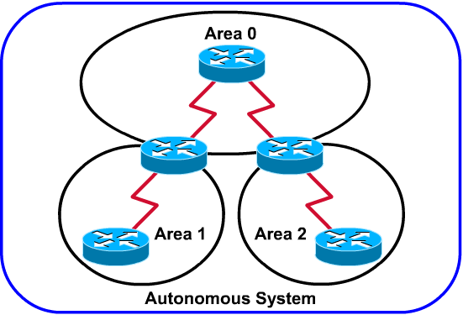
OSPF overview
Open Shortest Path First (OSPF) is a link-state routing protocol based on open standards.
The most recent description is RFC 2328. The Open in OSPF means that it is open to the public and is non-proprietary.
Notes:
Open Shortest Path First (OSPF) is a link-state routing protocol based on open standards. It is described in several standards of the Internet Engineering Task Force (IETF). The most recent description is RFC 2328. The Open in OSPF means that it is open to the public and is non-proprietary. OSPF is becoming the preferred IGP protocol when compared with RIP v1 and RIP v2 because it is scalable. RIP is limited to 15 hops, it converges slowly, and it sometimes chooses slow routes because it ignores critical factors such as bandwidth in route determination. OSPF overcomes these limitations and proves to be a robust and scalable routing protocol suitable for the networks of today. OSPF can be used and configured as a single area for small networks. It can also be used for large networks. OSPF routing scales to large networks if hierarchical network design principles are used.
Large OSPF networks use a hierarchical design. Multiple areas connect to a distribution area, area 0, also called the backbone. This design approach allows for extensive control of routing updates. Defining areas reduces routing overhead, speeds up convergence, confines network instability to an area and improves performance

Slide 18
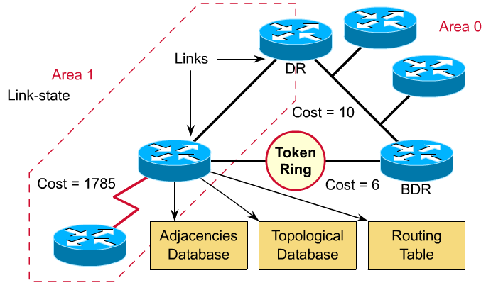
OSPF terminology
Notes:
© 2003, The SaigonCTT – A Regional Cisco Networking Academy
CNAP Semester <x> – <Chapter name>
<Chapter> - <number>
As a link-state protocol, OSPF operates differently from distance vector routing protocols. Link-state routers identify neighboring routers and then communicate with the identified neighbors. OSPF has its own terminology.
Link- an interface on a router
Link state—The status of a link between two routers, that is a router’s interface and its relationship to its neighboring routers.
Area—A collection of networks and routers that have the same area identification. Each router within an area has the same link-state information. A router within an area is an “internal” router.
Link Cost—The value assigned to a link. Rather than hops, link-state protocols assign a cost to a link that is based on the speed of the media. A cost is associated with the output side of each router interface, referred to as “Interface Output Cost”.
Adjacency database —A listing of all the neighbors to which a router has established bi-directional communication. Not every pair of neighboring routers become adjacent.
Link-state database, also known as a topological database—A list of link-state entries of all other routers in the internetwork. It shows the internetwork topology. All routers within an area have identical link-state databases. The link-state database is pieced together from LSAs generated by routers
Routing table—The routing table (also known as forwarding database) generated when an algorithm is run on the link-state database. Each router’s routing table is unique.
Designated router (DR) and backup designated router (BDR)—A router that is elected by all other routers on the same LAN to represent all the routers. Each network has a DR and BDR. These routers have special responsibilities that are discussed later in this chapter.

Slide 19
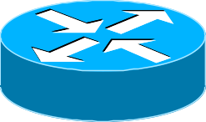
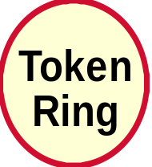
OSPF terminology: Links
An interface on Router
Links
Notes:
© 2003, The SaigonCTT – A Regional Cisco Networking Academy
CNAP Semester <x> – <Chapter name>
<Chapter> - <number>

Slide 20
OSPF terminology: Link state
The status of a link between two routers. Also a router’s interface and its relationship to its neighboring routers.
Neighbors
Links
Notes:
© 2003, The SaigonCTT – A Regional Cisco Networking Academy
CNAP Semester <x> – <Chapter name>
<Chapter> - <number>

Slide 21
OSPF terminology: Area
A collection of networks and routers that have the same area identification.
Each router within an area has the same link-state information.
A router within an area is an “internal” router
Area 1
Area 0
Notes:
© 2003, The SaigonCTT – A Regional Cisco Networking Academy
CNAP Semester <x> – <Chapter name>
<Chapter> - <number>

Slide 22
OSPF Areas—Example
Area 3
Area 0
Area 2
Area 1
Notes:
OSPF uses a 2 level hierarchical model
Areas defined with 32 bit number
Defined in IP address format
Can also be defined using single decimal value (ie. Area 0.0.0.0 is Area 0)
0.0.0.0 reserved for the backbone area
All areas must connect to area 0.0.0.0

Slide 23
OSPF terminology: Link Cost
The value assigned to a link. Rather than hops, link-state protocols assign a cost to a link that is based on the speed of the media.
Interface Output Cost.
Neighbors
Interfaces
Cost = 10
Cost = 1785
Cost = 6
Notes:
© 2003, The SaigonCTT – A Regional Cisco Networking Academy
CNAP Semester <x> – <Chapter name>
<Chapter> - <number>
Derived from bandwidth
10^8 ÷ bandwidth 56-kbps serial link = 1785
Ethernet/Token ring=10/6 64-kbps serial link = 1562
T1 (serial link) = 64 Fast Ethernet/FDDI = 1
Bandwidth dividend is user configurable:
Interface subcommand: bandwidth
Interface subcommand: ip ospf cost
Router subcommand : ospf auto-cost reference bandwidth

Slide 24
OSPF terminology: Adjacency database
A listing of all the neighbors to which a router has established bi-directional communication. Not every pair of neighboring routers become adjacent
Neighbors
Adjacency
database
Notes:
© 2003, The SaigonCTT – A Regional Cisco Networking Academy
CNAP Semester <x> – <Chapter name>
<Chapter> - <number>
Neighbor: Two routers that have interfaces on a common network. Neighbor relationship are usually discovered and maintained by the Hello protocol.

Slide 25
OSPF terminology: Link-state database
Also known as a topological database
A list of link-state entries of all other routers in the internetwork
Adjacency
database
Topological
Database
Notes:
© 2003, The SaigonCTT – A Regional Cisco Networking Academy
CNAP Semester <x> – <Chapter name>
<Chapter> - <number>
Link-state database, also known as a topological database—A list of link-state entries of all other routers in the internetwork. It shows the internetwork topology. All routers within an area have identical link-state databases. The link-state database is pieced together from LSAs generated by routers

Slide 26
OSPF terminology: Routing table
The routing table (also known as forwarding database) generated when an algorithm is run on the link-state database.
Each router’s routing table is unique
Adjacency
Database
Lists neighbors
Topological
Database
Lists all routes
Routing
Table
Lists best routes
Notes:
© 2003, The SaigonCTT – A Regional Cisco Networking Academy
CNAP Semester <x> – <Chapter name>
<Chapter> - <number>

Slide 27
OSPF terminology: DR and BDR router
Designated router (DR) and backup designated router (BDR):
  A router that is elected by all other routers on the same LAN to represent all the routers.
  Each network has a DR and BDR
DR
BDR
Notes:
© 2003, The SaigonCTT – A Regional Cisco Networking Academy
CNAP Semester <x> – <Chapter name>
<Chapter> - <number>

Slide 28
Comparing OSPF with distance vector routing protocols
Distance vector | OSPF
View network topology from neighbors’ perspective Adds distance vectors from router to router Frequent, periodic update: Slow convergence Passes copies routing tables to neighbor routers Use flat topology | Gets common view of entire network topology Calculates the shortest path to other routers Event-triggered update: Fast to convergence Passes link-state routing updates to other routers Allow hierarchical design for large internetworks Support for VLSM
Notes:
OSPF uses link-state technology, compared with distance vector technology such as RIP. Link-state routers maintain a common picture of the network and exchange link information upon initial discovery or network changes. Link-state routers do not broadcast their routing tables periodically as distance vector protocols do. Therefore, link-state routers use less bandwidth for routing table maintenance.
RIP is appropriate for small networks, and the best path is based on the lowest number of hops. OSPF is appropriate for the needs of large scalable internetworks, and the best path is determined by speed. RIP and other distance vector protocols use simple algorithms to compute best paths. The SPF algorithm is complex. Routers implementing distance vector routing may need less memory and less powerful processors than those running OSPF.
OSPF selects routes based on cost, which is related to speed. The higher the speed, the lower the OSPF cost of the link.
OSPF selects the fastest loop-free path from the shortest-path first tree as the best path in the network.
OSPF guarantees loop-free routing. Distance vector protocols may cause routing loops.
If links are unstable, flooding of link-state information can lead to unsynchronized link-state advertisements and inconsistent decisions among routers.
OSPF addresses the following issues:
Speed of convergence
Support for Variable Length Subnet Mask (VLSM)
Network size
Path selection
Grouping of members
In large networks RIP convergence can take several minutes since the routing table of each router is copied and shared with directly connected routers. After initial OSPF convergence, maintaining a converged state is faster because only the changes in the network are flooded to other routers in an area.
OSPF supports VLSMs and therefore is referred to as a classless protocol. RIP v1 does not support VLSMs, however, RIP v2 does support VLSMs.
RIP considers a network that is more than 15 routers away to be unreachable because the number of hops is limited to 15. This limits RIP to small topologies. OSPF has no size limits and is suitable for intermediate to large networks.
RIP selects a path to a network by adding one to the hop count reported by a neighbor. It compares the hop counts to a destination and selects the path with the smallest distance or hops. This algorithm is simple and does not require a powerful router or a lot of memory. RIP does not take into account the available bandwidth in best path determination.
OSPF selects a path using cost, a metric based on bandwidth. All OSPF routers must obtain complete information about the networks of every router to calculate the shortest path. This is a complex algorithm. Therefore, OSPF requires more powerful routers and more memory than RIP.
RIP uses a flat topology. Routers in a RIP region exchange information with all routers. OSPF uses the concept of areas. A network can be subdivided into groups of routers. In this way OSPF can limit traffic to these areas. Changes in one area do not affect performance in other areas. This hierarchical approach allows a network to scale efficiently.

Slide 29
Shortest path algorithm
1
4
C
B
A
4
2
D
1
E
F
G
2
2
The best path is the lowest cost path.
Notes:
The shortest path algorithm is used by OSPF to determine the best path to a destination. In this algorithm, the best path is the lowest cost path. The algorithm was discovered by Dijkstra, a Dutch computer scientist, and was explained in 1959. The algorithm considers a network to be a set of nodes connected by point-to-point links. Each link has a cost. Each node has a name. Each node has a complete database of all the links and so complete information about the physical topology is known. All router link-state databases are identical. The table in Figure shows the information that node D has received. For example, D received information that it was connected to node C with a link cost of 4 and to node E with a link cost of 1.

Slide 30
Shortest Path First Tree for node B
B
1
4
(1, B)
C
A
(4, B)
2
2
D
(4, E)
1
E
F
G
2
2
(3, C)
(5, E)
(6, A)
Notes:
The shortest path algorithm then calculates a loop-free topology using the node as the starting point and examining in turn information it has about adjacent nodes. In Figure , node B has calculated the best path to D. The best path to D is by way of node E, which has a cost of 4. This information is converted to a route entry in B which will forward traffic to C. Packets to D from B will flow B to C to E, then to D in this OSPF network.
In the example, node B determined that to get to node F the shortest path has a cost of 5, via node C. All other possible topologies will either have loops or a higher cost paths.

Slide 31
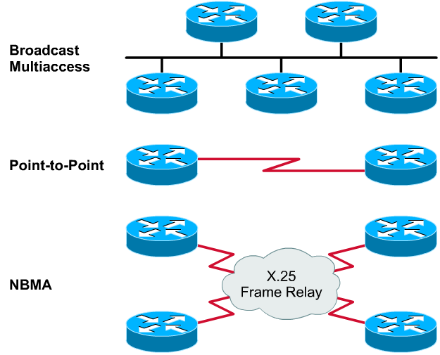
OSPF network types
Notes:
A neighbor relationship is required for OSPF routers to share routing information. A router will try to become adjacent, or neighbor, to at least one other router on each IP network to which it is connected. Some routers may try to become adjacent to all their neighbor routers. Other routers may try to become adjacent to only one or two neighbor routers. OSPF routers determine which routers to become adjacent to based on the type of network they are connected to. Once an adjacency is formed between neighbors, link-state information is exchanged. OSPF interfaces recognize three types of networks:
Broadcast multi-access, such as Ethernet
Point-to-point networks
Nonbroadcast multi-access (NBMA), such as Frame Relay

Slide 32
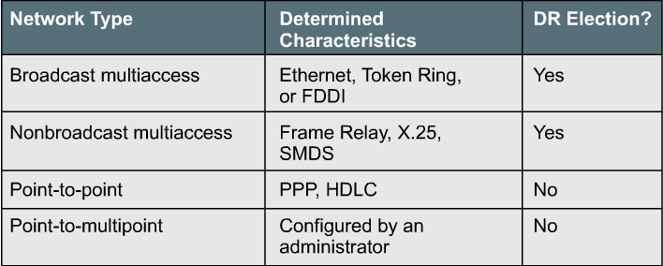
OSPF network types: Fourth type
Notes:
A fourth type, point-to-multipoint, can be configured on an interface by an administrator.
In a multiaccess network, the number of routers that will be connected in advance is unknown. In point-to-point networks, only two routers can be connected.

Slide 33
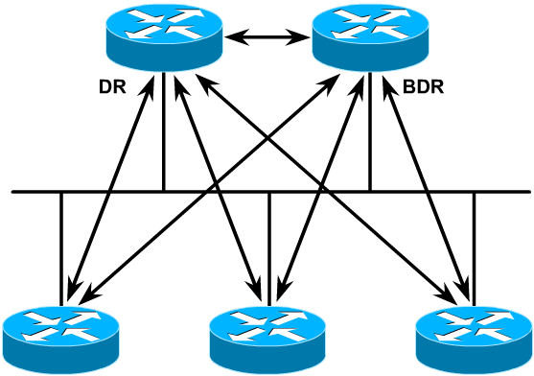
DR and BDR receive LSAs
Hellos elect DR and BDR to present segment
Each router then forms adjacency with DR and BDR
Notes:
In a broadcast multi-access network segment, many routers may be connected. If every router had to establish full adjacency with every other router and exchange link-state information with every neighbor, there would be too much overhead. If there are 5 routers, 10 adjacency relationships would be needed and 10 link states sent. If there are 10 routers then 45 adjacencies would be needed. In general, for n routers, n*(n-1)/2 adjacencies would need to be formed
The solution to this overhead is to hold an election for a designated router (DR). This router becomes adjacent to all other routers in the broadcast segment. All other routers on the segment send their link-state information to the DR. The DR in turn acts as the spokesperson for the segment. Using the example numbers above, only 5 and 10 sets of link states need be sent respectively. The DR sends link-state information to all other routers on the segment using the multicast address of 224.0.0.5 for all OSPF routers.
Despite the gain in efficiency that electing a DR provides, there is a disadvantage. The DR represents a single point of failure. A second router is elected as a backup designated router (BDR) to take over the duties of the DR if it should fail. To ensure that both the DR and the BDR see the link states all routers send on the segment, the multicast address for all designated routers, 224.0.0.6, is used.
On point-to-point networks only two nodes exist and no DR or BDR is elected. Both routers become fully adjacent with each other.

Slide 34
OSPF Hello Protocol
The rules that govern the exchange of OSPF hello packets are called the Hello protocol.
Hello packets use : 224.0.0.5 (all routers).
Hello packets are sent at regular intervals (default):
  Multi access and Point-to-point: 10s
  NBMA : 30s
On multi-access networks the Hello protocol elects a designated router (DR) and a backup designated router (BDR).
The hello packet carries information that all neighbors must agree upon before an adjacency is formed, and link-state information is exchanged.
Notes:
© 2003, The SaigonCTT – A Regional Cisco Networking Academy
CNAP Semester <x> – <Chapter name>
<Chapter> - <number>
The OSPF Hello Protocol
When a router starts an OSPF routing process on an interface, it sends a hello packet and continues to send hellos at regular intervals. The rules that govern the exchange of OSPF hello packets are called the Hello protocol. At Layer 3 of the OSI model, the hello packets are addressed to the multicast address 224.0.0.5. This address is “all OSPF routers”. OSPF routers use hello packets to initiate new adjacencies and to ensure that neighbor routers are still functioning. Hellos are sent every 10 seconds by default on broadcast multi-access and point-to-point networks. On interfaces that connect to NBMA networks, such as Frame Relay, the default time is 30 seconds.
On multi-access networks the Hello protocol elects a designated router (DR) and a backup designated router (BDR).
Although the hello packet is small, it consists of the OSPF packet header. For the hello packet the type field is set to 1.
The hello packet carries information that all neighbors must agree upon before an adjacency is formed, and link-state information is exchanged.

Slide 35
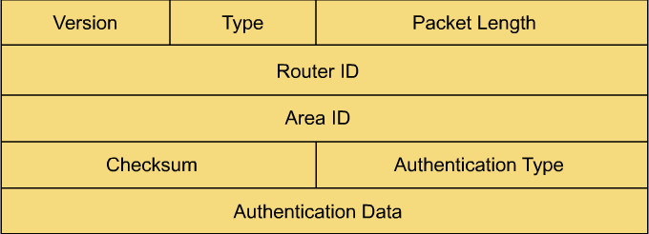
OSPF packet header
For the hello packet the type field is set to 1.
Notes:
All five types of OSPF packets use the OSPF packet header, which consists of eight fields. The purpose of each of these fields is described below:
Version, Type, and Packet Length - The first three fields of the OSPF packet let the recipients know the version of OSPF that is being used by the sender (version 1 and 2), the OSPF packet type, and length. OSPF version 2 was first introduced in 1991 (RFC 1247) and is not compatible with version 1, which is obsolete. The Cisco IOS uses OSPF version 2 and cannot be configured to use OSPF version 1.
Router ID - The function of the hello packet is to establish and maintain adjacencies, so the sending router signs the fourth field with its router ID, which is a 32-bit number used to identify the router to the OSPF protocol. A router uses its IP address as its ID because both the router ID and the IP address must be unique within a network. Because routers support multiple IP addresses, a loopback IP address is used as the router ID. In the absence of a loopback IP address, the highest-value address interface IP is used as the router ID, regardless of whether that interface is involved in the OSPF process.
If the interface associated with that IP address goes down, the router can no longer use that IP address as its router ID. When a router's ID changes for any reason, the router must reintroduce itself to its neighbors on all links. To avoid the unnecessary overhead caused by re-establishing adjacency and readvertising link states, an administrator typically assigns an IP address to a loopback interface. Unless an administrator shuts down a loopback interface, it always stays up, so loopback interfaces make ideal router IDs.
Note: If a loopback interface is configured with an IP address, the Cisco IOS will use that IP address as the router ID, even if the other interfaces have higher addresses.
Area ID - You can define multiple areas within an OSPF network to reduce and summarize route information, which allows large and complex networks to continue to grow. When configuring a single-area OSPF network, you should always use Area 0 because it is defined as the "backbone" area. You must have a backbone area to scale (add other OSPF areas).
Checksum - As you may have seen with other protocols, a 2-byte checksum field is used to check the message for errors. Good packets are retained and damaged packets are discarded.
Authentication Type and Authentication Data - OSPF supports different methods of authentication so that OSPF routers will not believe just anyone sending hellos to 224.0.0.5. Routers with unequal authentication fields will not accept OSPF information from each other.

Slide 36
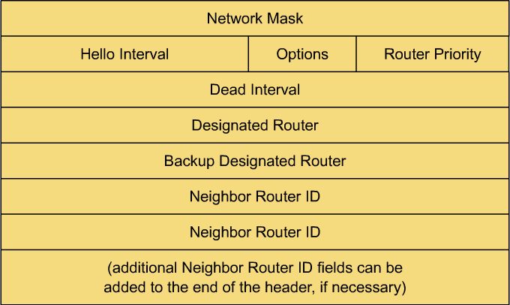
OSPF Hello Protocol - Hello header
Notes:
© 2003, The SaigonCTT – A Regional Cisco Networking Academy
CNAP Semester <x> – <Chapter name>
<Chapter> - <number>
The hello header , which is found only in Type-1 hello packets, carries essential information. The following are the fields in the hello header:
Network Mask - This 32-bit field carries subnet mask information for the network.
Hello Interval and Dead Interval - The hello interval is the number of seconds that an OSPF router waits to send the next hello packet. The default for multiaccess broadcast and point-to-point networks is 10 seconds. The dead interval is the number of seconds that a router waits before it declares a neighbor down (if the neighbor's hello packets are no longer being received). The dead interval is four times the hello interval by default, or 40 seconds. Both of these intervals are configurable, which is the reason they are advertised. If two routers have different hello intervals or if they have different dead intervals, they will not accept OSPF information from each other.
Options - The router can use this field to indicate optional configurations, including the stub area flag, which is discussed in Chapter 5.
Router Priority - This field contains a value that indicates the priority of this router when selecting a designated router (DR) and backup designated router (BDR). The default priority is 1 and can be configured to a higher number to ensure that a specified router becomes the DR.
Designated Router and Backup Designated Router - The router IDs of the DR and BDR are listed here, if known by the source of the hello packet.
Neighbor Address - If the source of the hello packet has received a valid hello from any neighbor within the dead interval, its router ID is included here.

Slide 37
Steps in the operation of OSPF
5 steps of operation:
Establish router adjacencies.
Elect a DR and BDR (if necessary).
Discover routes.
Select the appropriate routes to use.
Maintain routing information.
Notes:
© 2003, The SaigonCTT – A Regional Cisco Networking Academy
CNAP Semester <x> – <Chapter name>
<Chapter> - <number>

Slide 38

OSPF Topologies
Broadcast
Multiaccess
Point-to-Point
NBMA
X.25
Frame Relay
Notes:
© 2003, The SaigonCTT – A Regional Cisco Networking Academy
CNAP Semester <x> – <Chapter name>
<Chapter> - <number>

Slide 39
OSPF Operation in a
Broadcast Multiaccess Topology
Broadcast
Multiaccess
© 2000, Cisco Systems, Inc.
www.cisco.com
4-<number>
Notes:
© 2003, The SaigonCTT – A Regional Cisco Networking Academy
CNAP Semester <x> – <Chapter name>
<Chapter> - <number>

Slide 40
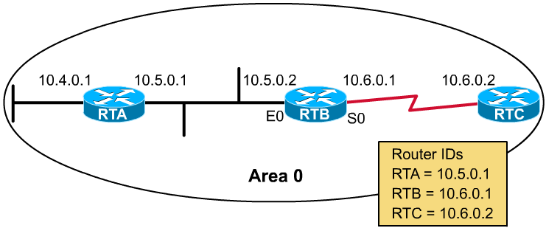
Step 1: Establish router adjacencies
First step in OSPF operation is to establish router adjacencies
RTB sends hello packets, advertising its own router ID → highest IP address:10.6.0.1(no loopback)
Notes:
© 2003, The SaigonCTT – A Regional Cisco Networking Academy
CNAP Semester <x> – <Chapter name>
<Chapter> - <number>
A router's first step in OSPF operation is to establish router adjacencies. Each of the three routers shown in the figure attempts to become adjacent to another router on the same IP network. To become adjacent with another router, RTB sends hello packets, advertising its own router ID.
Because no loopback interfaces are present, RTB chooses its highest IP address, 10.6.0.1, as its router ID.
Assuming that RTB is appropriately configured, RTB multicasts hello packets out both S0 and E0. RTA and RTC should both receive the hello packets. These two routers then add RTB to the Neighbor ID field of their respective hello packets and enter the Init state with RTB.
RTB receives hello packets from both of its neighbors and sees its own ID number (10.6.0.1) in the Neighbor ID field. RTB declares a Two-Way state between itself and RTA, and a Two-Way state between itself and RTC.
At this point, RTB determines which routers to establish adjacencies with, based on the type of network that a particular interface resides on. If the network type is point-to-point, the router becomes adjacent with its sole link partner. If the network type is multiaccess, RTB enters the election process to become a DR or BDR, unless both roles are already established (as advertised in the hello packet header).
If an election is necessary, OSPF routers will proceed as described in the next section, Step 2: Elect a DR and a BDR. However, if an election is not necessary, the routers will enter the ExStart state, as described in the section, Step 3: Discover Routes.

Slide 41
Step 1: Establish router adjacencies (cont.)
D
E
Hello
Router ID
Hello/dead intervals
Neighbors
Area-ID
Router priority
DR IP address
BDR IP address
Authentication password
Stub area flag
B
A
C
*
afadjfjorqpoeru
39547439070713
*
Hello
*
*
* Entry must match on neighboring routers
Notes:
© 2003, The SaigonCTT – A Regional Cisco Networking Academy
CNAP Semester <x> – <Chapter name>
<Chapter> - <number>
Because OSPF routing is dependent on the status of a link between two routers, neighbor routers must “recognize” each other on the network before they can share information. This process is done using the Hello protocol. The Hello Protocol is responsible for establishing and maintaining neighbor relationships.. It ensures that the communication between neighbors is bi-directional, where a router sees itself listed in the Hello packet it received from a neighbor. Hello packets are sent periodically out of each interface participating in OSPF using IP multicast address 224.0.0.5.
The information contained in a Hello packet is as follows:
— Router ID — A 32-bit number which uniquely identifies the router within an Autonomous System. The highest IP address on an active interface is chosen by default, for example, IP address 131.108.13.5 would be chosen over 128.11.4.1. This identification is important in establishing neighbor relationships and coordinating messages between copies of the SPF algorithm running in the network. Also, the router ID is used to break ties during the DR and BDR election processes if the priority values are equal. (DR and BDR are discussed later.)
— Hello and dead intervals — The hello interval specifies the frequency in seconds that a router sends hellos (ten-second default on multi-access networks). The dead interval is the time in seconds that a router waits to hear from a neighbor before declaring the neighbor router down (four times the hello interval by default). These timers must be the same on neighboring routers.
— Neighbors—The neighbors to which a bi-directional communication has been established. Bi-directional communication is indicated when the router sees itself listed in the neighbor's Hello Packet. (At this point, this field is empty.)
— Area-ID—To communicate, two routers must share a common segment and have their interfaces belong to the same area on that segment (also same subnet and mask). These routers will all have the same link-state information.
— Router Priority— An 8-bit number that indicates the priority of this router when selecting a designated DR and BDR.
— DR and BDR—If known, the IP addresses of the DR and BDR for the specific network(covered in next section).
— Authentication password—If authentication is enabled, two routers must exchange the same password. Authentication does not have to be set, but
if it is set, all peer routers must have the same password. — Stub area flag—A stub area is a special area that will be discussed in the next chapter. Two routers must agree on the stub area flag in the hello packets.

Slide 42
Step 2: Electing the DR and BDR (if necessary).
P=3
P=2
DR
BDR
Hello
P=1
P=1
P=0
The router with the highest priority value is the DR.
The router with the second highest priority value is the BDR.
The default for the interface OSPF priority is 1. In case of a tie, the router’s router ID is used.
Notes:
© 2003, The SaigonCTT – A Regional Cisco Networking Academy
CNAP Semester <x> – <Chapter name>
<Chapter> - <number>
To elect a DR and BDR, the routers view each other’s priority value during the hello packet exchange process, and use the following conditions to determine which is elected:
The router with the highest priority value is the DR.
The router with the second highest priority value is the BDR.
The default for the interface OSPF priority is 1. In case of a tie, the router’s router ID is used.
A router with a priority set to 0 is ineligible to become DR or BDR.
If a router with a higher priority value gets added to the network, the DR and BDR do NOT change. The only time a DR or BDR will change is if one goes down. If the DR goes down, then the BDR takes over as the DR and a new BDR is elected. If the BDR goes down, a new BDR is elected.
To determine if the DR is down, the BDR sets a timer. This is a reliability feature. If the BDR does not hear the DR forwarding link-state advertisements (LSAs) before the timer expires, then the BDR assumes the DR is out of service. In a multiaccess environment, each network segment will have its own DR and BDR. Therefore a router that is connected to multiple networks can be a DR on one segment and a regular router on another segment.

Slide 43
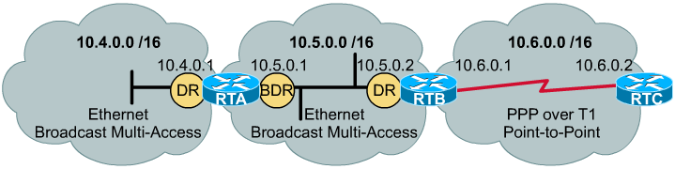
Step 3: Discover routes
On difference network have differ discover process.
  On multi-access network, the exchange of routing information occurs between the DR or BDR and every other router on the network.
  Link partners on a point-to-point or point-to-multipoint network also engage in the exchange process.
Notes:
© 2003, The SaigonCTT – A Regional Cisco Networking Academy
CNAP Semester <x> – <Chapter name>
<Chapter> - <number>
On a multiaccess network, the exchange of routing information occurs between the DR or BDR and every other router on the network. As the DR and BDR on the 10.5.0.0 /16 network, RTA and RTB will exchange link-state information. Link partners on a point-to-point or point-to-multipoint network also engage in the exchange process. That means that RTB and RTC will share link-state data

Slide 44
Exchange Process
172.16.5.1/24
E0
172.16.5.2/24
E1
A
B
Down State
I am router ID 172.16.5.1 and I see no one.
Init State
Router B
Neighbors List
172.16.5.1/24, int E1
I am router ID 172.16.5.2, and I see 172.16.5.1.
Router A
Neighbors List
172.16.5.2/24, int E0
Two-way State
Notes:
© 2003, The SaigonCTT – A Regional Cisco Networking Academy
CNAP Semester <x> – <Chapter name>
<Chapter> - <number>
Router A is enabled on the LAN and is in a down state because it has not exchanged information with any other router. It begins by sending a hello packet through each of its interfaces participating in OSPF, even though it does not know the identity of the DR or of any other routers. The Hello packet is sent out using multicast address 224.0.0.5.
All routers running OSPF receive the hello packet from router A and add router A to their list of neighbors. This is the Init state.
All routers that received the packet send a unicast reply hello packet to router A with their corresponding information, as listed in step 1. The neighbor field includes all other neighboring routers, including router A.
When router A receives these packets, it adds all the routers that had its (router A’s) router ID in their packet to its own neighborship database. This is referred to as the two-way state. At this point, all routers that have each other in their list of neighbors have established bi-directional communication.
The routers determine who the DR and BDR will be. The DR and BDR election process is described in the next subsection, “Electing the DR and BDR.” This process must occur before routers can begin exchanging link-state information. Link-state exchanges are discussed in the “Discovering Routes” subsection.
Periodically (ten seconds by default) the routers within a network exchange hello packets to ensure communication is still working. The hello updates include the DR/BDR and the list of routers whose hello packets have been received by the router. Remember that “received” means that the receiving router saw its name as one of the entries in the received hello packet.

Slide 45
Step 3: Discover routes (cont.)
DR
E0
172.16.5.1
E0
172.16.5.3
Exstart State
afadjfjorqpoeru
39547439070713
I will start exchange because I have router ID 172.16.5.1.
Hello
No, I will start exchange because I have a
higher router ID.
afadjfjorqpoeru
39547439070713
Hello
Exchange State
afadjfjorqpoeru
39547439070713
Here is a summary of my link-state database.
DBD
afadjfjorqpoeru
39547439070713
DBD
Here is a summary of my link-state database.
Notes:
© 2003, The SaigonCTT – A Regional Cisco Networking Academy
CNAP Semester <x> – <Chapter name>
<Chapter> - <number>
In the Exstart state, the DR and BDR establish adjacencies with each router in the network. During this process, a master-slave relationship is created between each router and its adjacent DR/BDR. The router that has the higher router ID acts as the master. Note that link-state information is exchanged and synchronized only between the DR/BDR and the routers to which they have established adjacencies because having the DR represent the network in this capacity reduces the amount of routing update traffic.
The master and slave routers exchange one or more database description packets (DBDs or DDPs), which is referred to as the Exchange state. A DBD includes the LSA entries that appear in the master router’s link-state database. The entries can be about a link or about a network. Each LSA entry includes such things as a link-state type, the address of the advertising router, the cost of the link, and the sequence number. The sequence number is a router’s way of determining the “newness” of the received link-state information. The sequence number used by the adjacent routers is the one defined by the master.
When the slave router receives the DBD, it does the following: — Acknowledges the receipt of the DBD by echoing the link-state entry sequence numbers in a link- tate acknowledgment (LSAck) packet. — Compares the information it received with the information it has. Remember that the initial entries put into the link-state database are from the adjacencies database. If the DBD has a more up-to-date link-state entry, then the slave router sends a link-state request (LSR) to the master router. The master router responds with the complete information about the requested entry in a link-state update (LSU) packet. Again, the slave router sends an LSAck when the LSU is received. The process of sending LSRs is referred to as the Loading state.
All routers add the new link-state entries into their link-state database.
Once all LSRs have been satisfied for a given router, the adjacent routers are considered synchronized and in a Full state. The routers must be in a Full state before they can route traffic. At this point, the routers should all have identical link-state databases.

Slide 46
Step 3: Discover routes (cont.)
DR
E0
172.16.5.1
E0
172.16.5.3
afadjfjorqpoeru
39547439070713
afadjfjorqpoeru
39547439070713
LSAck
Thanks for the information!
LSAck
Loading State
afadjfjorqpoeru
39547439070713
I need the complete entry for network 172.16.6.0/24.
LSR
afadjfjorqpoeru
39547439070713
Here is the entry for network 172.16.6.0/24.
LSU
afadjfjorqpoeru
39547439070713
LSAck
Thanks for the information!
Full State
Notes:
© 2003, The SaigonCTT – A Regional Cisco Networking Academy
CNAP Semester <x> – <Chapter name>
<Chapter> - <number>
In the Exstart state, the DR and BDR establish adjacencies with each router in the network. During this process, a master-slave relationship is created between each router and its adjacent DR/BDR. The router that has the higher router ID acts as the master. Note that link-state information is exchanged and synchronized only between the DR/BDR and the routers to which they have established adjacencies because having the DR represent the network in this capacity reduces the amount of routing update traffic.
The master and slave routers exchange one or more database description packets (DBDs or DDPs), which is referred to as the Exchange state. A DBD includes the LSA entries that appear in the master router’s link-state database. The entries can be about a link or about a network. Each LSA entry includes such things as a link-state type, the address of the advertising router, the cost of the link, and the sequence number. The sequence number is a router’s way of determining the “newness” of the received link-state information. The sequence number used by the adjacent routers is the one defined by the master.
When the slave router receives the DBD, it does the following: — Acknowledges the receipt of the DBD by echoing the link-state entry sequence numbers in a link- tate acknowledgment (LSAck) packet. — Compares the information it received with the information it has. Remember that the initial entries put into the link-state database are from the adjacencies database. If the DBD has a more up-to-date link-state entry, then the slave router sends a link-state request (LSR) to the master router. The master router responds with the complete information about the requested entry in a link-state update (LSU) packet. Again, the slave router sends an LSAck when the LSU is received. The process of sending LSRs is referred to as the Loading state.
All routers add the new link-state entries into their link-state database.
Once all LSRs have been satisfied for a given router, the adjacent routers are considered synchronized and in a Full state. The routers must be in a Full state before they can route traffic. At this point, the routers should all have identical link-state databases.

Slide 47

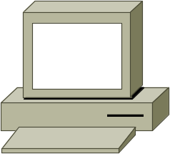
Step 4: Choosing Routes
10.1.1.0/24
10.2.2.0/24
10.3.3.0/24
A
B
C
Cost=6
Cost=1
Cost=10
10.4.4.0/24
Topology Table
Net Cost Out Interface
10.2.2.0 6 To0
10.3.3.0 7 To0
10.3.3.0 10 E0
This is the best route to 10.3.3.0.
Notes:
© 2003, The SaigonCTT – A Regional Cisco Networking Academy
CNAP Semester <x> – <Chapter name>
<Chapter> - <number>
Once a router has a complete link-state database, it is ready to create its routing table so it can route - forward traffic. Recall that distance vector protocols such as RIP select the best route to a destination based on a hop count metric. The Bellman-Ford algorithm is run to determine the routes with the lowest hop count. Link-state protocols use a cost metric to determine the best path to a destination. The default cost metric is based on media bandwidth. For example, 10-Mbps Ethernet has a lower cost than a 56kbps line because it is faster. To calculate the lowest cost to a destination, link-state protocols such as OSPF use the Dijkstra algorithm. Using its link-state database as input, a router runs the Dijkstra Algorithm, thus building its routing table step by step. In simple terms, the algorithm adds up the total costs between the local router (the root) and each destination network. If there are multiple paths to a destination, the lowest-cost path is preferred. But note that OSPF keeps up to six equal cost route entries in the routing table for load balancing. Sometimes a link, such as a serial line, will go up and down rapidly (called flapping), or a link-state change may affect another series of links. In these situations, a series of LSUs could be generated, which would cause routers to repeatedly recompute a new routing table. This flapping could be so serious that the routers would never converge. To minimize this problem, each time an LSU is received the router waits for a period of time before recalculating its routing table. The timers spf holdtime - spf command was added to the Cisco IOS software to prevent routers from computing a new routing table after fewer than 10 seconds (default). Refer to the OSPF version 2 RFC 2328 for a detailed description of the Dijkstra algorithm.

Slide 48
Step 5: Maintaining Routing Information
Link-State Change
DR
1
x
LSU
x
A
B
Router A tells all OSPF DRs on 224.0.0.6
Notes:
© 2003, The SaigonCTT – A Regional Cisco Networking Academy
CNAP Semester <x> – <Chapter name>
<Chapter> - <number>
In a link-state routing environment, it is very important for all routers' topological databases to stay synchronized. When there is a change in a link-state, the routers use a flooding process to notify the other routers in the network of the change. Link State Update packets provide the mechanism for flooding LSAs. In general, the flooding process is as follows:
A router notices a change in a link state and multicasts an LSU packet that includes the updated LSA entry to 224.0.0.6, the “all OSPF DRs” (and BDR) address. . An LSU packet may contain several distinct LSAs.
The DR acknowledges the receipt of the change and floods the LSU to others on the network using the OSPF multicast address 224.0.0.5. To make the flooding procedure reliable, each LSA must be acknowledged separately. After receiving the LSU, each router responds to the DR with an LSAck.
If a router is connected to another network, it floods the LSU to other networks by forwarding the LSU to the DR of the multi-access network, or adjacent router if in a point-to-point network. The DR, in turn, multicasts the LSU to the other routers in the network.
When a router receives the LSU that includes the changed LSU, the router updates its link-state database. It then computes the SPF algorithm with the new database to generate a new routing table. After a short delay, it switches over to the new routing table.
OSPF simplifies the synchronization issue by requiring only adjacent routers to remain synchronized.
Note In a Cisco router, if a route already exists, the routing table is used simultaneously as the SPF is calculating. But if the SPF is calculating a new route, the use of the routing table occurs after the SPF calculation is complete.

Slide 49
Step 5: Maintaining Routing Information
2
Link-State Change
LSU
DR
1
x
LSU
x
A
B
Router A tells all OSPF DRs on 224.0.0.6
DR tells all others on 224.0.0.5
Notes:
© 2003, The SaigonCTT – A Regional Cisco Networking Academy
CNAP Semester <x> – <Chapter name>
<Chapter> - <number>
A router notices a change in a link state and multicasts an LSU packet that includes the updated LSA entry to 224.0.0.6, the “all OSPF DRs” (and BDR) address. . An LSU packet may contain several distinct LSAs.
The DR acknowledges the receipt of the change and floods the LSU to others on the network using the OSPF multicast address 224.0.0.5. To make the flooding procedure reliable, each LSA must be acknowledged separately. After receiving the LSU, each router responds to the DR with an LSAck.
If a router is connected to another network, it floods the LSU to other networks by forwarding the LSU to the DR of the multi-access network, or adjacent router if in a point-to-point network. The DR, in turn, multicasts the LSU to the other routers in the network.
When a router receives the LSU that includes the changed LSU, the router updates its link-state database. It then computes the SPF algorithm with the new database to generate a new routing table. After a short delay, it switches over to the new routing table.
OSPF simplifies the synchronization issue by requiring only adjacent routers to remain synchronized.
Note In a Cisco router, if a route already exists, the routing table is used simultaneously as the SPF is calculating. But if the SPF is calculating a new route, the use of the routing table occurs after the SPF calculation is complete.

Slide 50
Step 5: Maintaining Routing Information
2
Link-State Change
LSU
DR
1
x
LSU
x
3
A
B
LSU
Router A tells all OSPF DRs on 224.0.0.6
DR tells all others on 224.0.0.5
Notes:
© 2003, The SaigonCTT – A Regional Cisco Networking Academy
CNAP Semester <x> – <Chapter name>
<Chapter> - <number>
A router notices a change in a link state and multicasts an LSU packet that includes the updated LSA entry to 224.0.0.6, the “all OSPF DRs” (and BDR) address. . An LSU packet may contain several distinct LSAs.
The DR acknowledges the receipt of the change and floods the LSU to others on the network using the OSPF multicast address 224.0.0.5. To make the flooding procedure reliable, each LSA must be acknowledged separately. After receiving the LSU, each router responds to the DR with an LSAck.
If a router is connected to another network, it floods the LSU to other networks by forwarding the LSU to the DR of the multi-access network, or adjacent router if in a point-to-point network. The DR, in turn, multicasts the LSU to the other routers in the network.
When a router receives the LSU that includes the changed LSU, the router updates its link-state database. It then computes the SPF algorithm with the new database to generate a new routing table. After a short delay, it switches over to the new routing table.
OSPF simplifies the synchronization issue by requiring only adjacent routers to remain synchronized.
Note In a Cisco router, if a route already exists, the routing table is used simultaneously as the SPF is calculating. But if the SPF is calculating a new route, the use of the routing table occurs after the SPF calculation is complete.

Slide 51
Step 5: Maintaining Routing Information
2
Link-State Change
LSU
DR
4
I need to update
my routing table.
1
x
LSU
x
3
A
B
LSU
Router A tells all OSPF DRs on 224.0.0.6
DR tells all others on 224.0.0.5
Notes:
© 2003, The SaigonCTT – A Regional Cisco Networking Academy
CNAP Semester <x> – <Chapter name>
<Chapter> - <number>
A router notices a change in a link state and multicasts an LSU packet that includes the updated LSA entry to 224.0.0.6, the “all OSPF DRs” (and BDR) address. . An LSU packet may contain several distinct LSAs.
The DR acknowledges the receipt of the change and floods the LSU to others on the network using the OSPF multicast address 224.0.0.5. To make the flooding procedure reliable, each LSA must be acknowledged separately. After receiving the LSU, each router responds to the DR with an LSAck.
If a router is connected to another network, it floods the LSU to other networks by forwarding the LSU to the DR of the multi-access network, or adjacent router if in a point-to-point network. The DR, in turn, multicasts the LSU to the other routers in the network.
When a router receives the LSU that includes the changed LSU, the router updates its link-state database. It then computes the SPF algorithm with the new database to generate a new routing table. After a short delay, it switches over to the new routing table.
OSPF simplifies the synchronization issue by requiring only adjacent routers to remain synchronized.
Note In a Cisco router, if a route already exists, the routing table is used simultaneously as the SPF is calculating. But if the SPF is calculating a new route, the use of the routing table occurs after the SPF calculation is complete.
If an OSPF router is connected to another network, it floods the LSU to other networks by forwarding the LSU to the DR of the multiaccess network, or to an adjacent router if in a point-to-point network . The DR, in turn, multicasts the LSU to the other OSPF routers in that network.
Upon receiving an LSU that includes new information, an OSPF router updates its link-state database. It then runs the SPF algorithm using the new information to recalculate the routing table. After the SPF hold timer expires, the router switches over to the new routing table.
If a route already exists in a Cisco router, the old route is used while the SPF algorithm is calculating the new information. If the SPF algorithm is calculating a new route, the router will not use that route until after the SPF calculation is complete.
It is important to note that even if a change in link state does not occur, OSPF routing information is periodically refreshed. Each LSA entry has its own age timer. The default timer value is 30 minutes. After an LSA entry ages out, the router that originated the entry sends an LSU to the network to verify that the link is still active.

Slide 52
Step 5: Maintaining Routing Information (cont.)
LSU
Is entry in
link-state
database?
LSA
No
Add to database
Send LSAck
to DR
Flood LSA
Run SPF to calculate
new routing table
End
Notes:
© 2003, The SaigonCTT – A Regional Cisco Networking Academy
CNAP Semester <x> – <Chapter name>
<Chapter> - <number>
31
Each LSA entry has its own aging timer, carried in the LS Age field. The default timer value is 30 minutes (it is expressed in seconds in the LS age field). After an LSA entry ages, the router that originated the entry sends an LSU to the network to verify that the link is still active. This validation method saves on bandwidth compared to distance vector routers, which send their entire routing table. When each router receives the LSU, it does the following:
If the entry already exists and the received LSU has the same information, it ignores the LSA entry.
If the entry already exists but the LSU includes new information, it sends an LSAck to the DR, adds the entry to its link state database, and updates its routing table.
If the entry already exists but the LSU includes older information, it sends an LSU with its information.
Note Remember that there are different types of LSAs. In this chapter, the LSAs discussed are the router link LSA, which is an LSA about a link and its status, and the network LSA, which the DR sends out. The network LSA describes all the routers attached to a multiaccess segment. The next chapter will discuss other LSA types.

Slide 53
Step 5: Maintaining Routing Information (cont.)
LSU
Is entry in
link-state
database?
Is seq. #
the same?
LSA
Ignore LSA
Yes
Yes
No
Add to database
Send LSAck
to DR
Flood LSA
Run SPF to calculate
new routing table
End
Notes:
© 2003, The SaigonCTT – A Regional Cisco Networking Academy
CNAP Semester <x> – <Chapter name>
<Chapter> - <number>
33
Each LSA entry has its own aging timer, carried in the LS Age field. The default timer value is 30 minutes (it is expressed in seconds in the LS age field). After an LSA entry ages, the router that originated the entry sends an LSU to the network to verify that the link is still active. This validation method saves on bandwidth compared to distance vector routers, which send their entire routing table. When each router receives the LSU, it does the following:
If the entry already exists and the received LSU has the same information, it ignores the LSA entry.
If the entry already exists but the LSU includes new information, it sends an LSAck to the DR, adds the entry to its link state database, and updates its routing table.
If the entry already exists but the LSU includes older information, it sends an LSU with its information.
Note Remember that there are different types of LSAs. In this chapter, the LSAs discussed are the router link LSA, which is an LSA about a link and its status, and the network LSA, which the DR sends out. The network LSA describes all the routers attached to a multiaccess segment. The next chapter will discuss other LSA types.

Slide 54
Step 5: Maintaining Routing Information (cont.)
LSU
Is entry in
link-state
database?
Is seq. #
the same?
Ignore LSA
LSA
Yes
Yes
No
No
Add to database
Is seq. #
higher?
Send LSAck
to DR
No
Flood LSA
Send LSU
with newer
information to
source
Run SPF to calculate
new routing table
End
End
Notes:
© 2003, The SaigonCTT – A Regional Cisco Networking Academy
CNAP Semester <x> – <Chapter name>
<Chapter> - <number>
32
Each LSA entry has its own aging timer, carried in the LS Age field. The default timer value is 30 minutes (it is expressed in seconds in the LS age field). After an LSA entry ages, the router that originated the entry sends an LSU to the network to verify that the link is still active. This validation method saves on bandwidth compared to distance vector routers, which send their entire routing table. When each router receives the LSU, it does the following:
If the entry already exists and the received LSU has the same information, it ignores the LSA entry.
If the entry already exists but the LSU includes new information, it sends an LSAck to the DR, adds the entry to its link state database, and updates its routing table.
If the entry already exists but the LSU includes older information, it sends an LSU with its information.
Note Remember that there are different types of LSAs. In this chapter, the LSAs discussed are the router link LSA, which is an LSA about a link and its status, and the network LSA, which the DR sends out. The network LSA describes all the routers attached to a multiaccess segment. The next chapter will discuss other LSA types.

Slide 55
Step 5: Maintaining Routing Information (cont.)
LSU
Is entry in
link-state
database?
Is seq. #
the same?
Ignore LSA
LSA
Yes
Yes
No
No
A
Add to database
Go
to
A
Is seq. #
higher?
Yes
Send LSAck
to DR
No
Flood LSA
Send LSU
with newer
information to
source
Run SPF to calculate
new routing table
End
End
Notes:
© 2003, The SaigonCTT – A Regional Cisco Networking Academy
CNAP Semester <x> – <Chapter name>
<Chapter> - <number>
34
Each LSA entry has its own aging timer, carried in the LS Age field.
The default timer value is 30 minutes (it is expressed in seconds in the LS age field). After an LSA entry ages, the router that originated the entry sends an LSU to the network to verify that the link is still active. This validation method saves on bandwidth compared to distance vector routers, which send their entire routing table. When each router receives the LSU, it does the following:
If the entry already exists and the received LSU has the same information, it ignores the LSA entry.
If the entry already exists but the LSU includes new information, it sends an LSAck to the DR, adds the entry to its link state database, and updates its routing table.
If the entry already exists but the LSU includes older information, it sends an LSU with its information.
Note Remember that there are different types of LSAs. In this chapter, the LSAs discussed are the router link LSA, which is an LSA about a link and its status, and the network LSA, which the DR sends out. The network LSA describes all the routers attached to a multiaccess segment. The next chapter will discuss other LSA types.

Slide 56
OSPF Operation in a Point-to-Point
Point-to-Point Neighborship
  Router dynamically detects its neighboring router using the Hello protocol
  No election: Adjacency is automatic as soon as the two routers can communicate
  OSPF packets are always sent as multicast 224.0.0.5
Notes:
© 2003, The SaigonCTT – A Regional Cisco Networking Academy
CNAP Semester <x> – <Chapter name>
<Chapter> - <number>
A Point-to-point network joins a single pair of routers. A T1 serial line is an example of a point-to-point network. On point-to-point networks, the router dynamically detects its neighboring routers by sending its Hello packets to the multicast address AllSPFRouters, 224.0.0.0.5. On physical point-to-point networks, neighboring routers become adjacent whenever they can communicate directly. No election is performed. On physical point-to-point networks, the IP destination is always set to the multicast address AllSPFRouters, 224.0.0.5. On all other network types, the majority of OSPF packets are sent as unicasts, i.e., sent directly to the other end of the adjacency, sent as unicasts to the DR and BDR. It is possible to use IP unnumbered with OSPF. Usually, the IP source address is set to the address of the outgoing interface. Interfaces to unnumbered point-to-point networks have no associated IP address. On these interfaces, the IP source will be set to any of the other IP addresses belonging to the router.

Slide 57
OSPF Operation in an NBMA
X.25
Frame Relay
ATM
NBMA Topology
  Single interface interconnects multiple sites
  NBMA topologies support multiple routers but without broadcasting capabilities
Notes:
© 2003, The SaigonCTT – A Regional Cisco Networking Academy
CNAP Semester <x> – <Chapter name>
<Chapter> - <number>
Not discuss in CCNA
When a single interface is used to interconnect multiple sites, you may have reachability issues because of the nonbroadcast multiaccess (NBMA) nature of Frame Relay and X.25. With Frame Relay running multiple PVCs over a single interface, the primary issue is with split horizon. NBMA networks are those networks that support many (more than two) routers, but have no broadcast capability, such as Frame Relay. For the purpose of our NBMA presentation, we will work with a Frame Relay environment. By default, a Frame Relay network provides NBMA connectivity between remote sites. NBMA connectivity means that although all locations can reach each other, depending on the topology, routing update broadcasts received by one router cannot be forwarded to all locations because Frame Relay networks use split horizon to reduce the number of routing loops.

Slide 58
SINGLE AREA OSPF Configuration

Slide 59
Basic OSPF Configuration
Broadcast Network
Point-to-Point Network
E0
10.64.0.1
S0
10.2.1.2
10.64.0.2
E0
10. 2.1.1
S1
A
B
C
<Output Omitted>
interface Ethernet0
ip address 10.64.0.1 255.255.255.0
!
<Output Omitted>
<Output Omitted>
interface Ethernet0
ip address 10.64.0.2 255.255.255.0
!
interface Serial0
ip address 10.2.1.2 255.255.255.0
<Output Omitted>
router ospf 1
network 10.0.0.0 0.255.255.255 area 0
router ospf 50
network 10.2.1.2 0.0.0.0 area 0
network 10.64.0.2 0.0.0.0 area 0
Can Assign Network or
Interface Address.
Notes:
© 2003, The SaigonCTT – A Regional Cisco Networking Academy
CNAP Semester <x> – <Chapter name>
<Chapter> - <number>
OSPF routing uses the concept of areas. Each router contains a complete database of link-states in a specific area. An area in the OSPF network, it may be assigned any number from 0 to 65,535. However a single area is assigned the number 0 and is known as area 0.
In multi-area OSPF networks, all areas are required to connect to area 0. Area 0 is also called the backbone area. OSPF configuration requires that the configuration be enabled on the router with network addresses and area information.
Network addresses are configured with a wildcard mask and not a subnet mask. The wildcard mask represents the links or host addresses that can be present in this segment.
Area IDs can be written as a whole number or dotted decimal notation.
To enable OSPF routing, use the global configuration command syntax:
Router(config)#router ospf process-id
The process ID is a number that is used to identify an OSPF routing process on the router. Multiple OSPF processes can be started on the same router. The number can be any value between 1 and 65,535. Most network administrators keep the same process ID throughout an autonomous system, but this is not a requirement. It is rarely necessary to run more than one OSPF process on a router.
IP networks are advertised as follows in OSPF:
Router(config-router)#network address wildcard-mask area area-id
Each network must be identified with the area to which it belongs.
The network address can be a whole network, a subnet, or the address of the interface.
The wildcard mask represents the set of host addresses that the segment supports. This is different than a subnet mask, which is used when configuring IP addresses on interfaces.

Slide 60
Configuring OSPF loopback address
Router ID:
  Number by which the router is known to OSPF
  Default: The highest IP address on an active interface at the moment of OSPF process startup
  Can be overridden by a loopback interface: Highest IP address of any active loopback interface
! Create the loopback 0 interface
Router(configf)#Interface loopback 0
Router(configf-if)#ip address 192.168.31.33 255.255.255.255
! Remove loopback 0 interface
Router(configf)#no Interface loopback 0
Notes:
© 2003, The SaigonCTT – A Regional Cisco Networking Academy
CNAP Semester <x> – <Chapter name>
<Chapter> - <number>
When the OSPF process starts, the Cisco IOS uses the highest local active IP address as its OSPF router ID. If there is no active interface, the OSPF process will not start. If the active interface goes down, the OSPF process has no router ID and therefore ceases to function until the interface comes up again.
To ensure OSPF stability there should be an active interface for the OSPF process at all times. A loopback interface, which is a logical interface, can be configured for this purpose. When a loopback interface is configured, OSPF uses this address as the router ID, regardless of the value. On a router that has more than one loopback interface, OSPF takes the highest loopback IP address as its router ID.
To create and assign an IP address to a loopback interface use the following commands:
Router(config)#interface loopback number
Router(config-if)#ip address ip-address subnet-mask
It is considered good practice to use loopback interfaces for all routers running OSPF. This loopback interface should be configured with an address using a 32-bit subnet mask of 255.255.255.255. A 32-bit subnet mask is called a host mask because the subnet mask specifies a network of one host. When OSPF is requested to advertise a loopback network, OSPF always advertises the loopback as a host route with a 32-bit mask.

Slide 61
Configuring OSPF router priority
The router with the highest priority value is the DR.
The default for the interface OSPF priority is 1. In case of a tie, the router’s router ID is used.
! Setting OSPF Priority
Router(configf)#Interface Fastethernet 0/0
Router(configf-if)#ip ospf priority 50
The priorities can be set to any value from 0 to 255
The command show ip ospf interface will display the interface priority value as well as other key information.
Notes:
In broadcast multi-access networks there may be more than two routers. OSPF elects a designated router (DR) to be the focal point of all link-state updates and link-state advertisements. Because the DR role is critical, a backup designated router (BDR) is elected to take over if the DR fails.
If the network type of an interface is broadcast, the default OSPF priority is 1. When OSPF priorities are the same, the OSPF election for DR is decided on the router ID. The highest router ID is selected.
The election result can be determined by ensuring that the ballots, the hello packets, contain a priority for that router interface. The interface reporting the highest priority for a router will ensure that it becomes the DR.
The priorities can be set to any value from 0 to 255. A value of 0 prevents that router from being elected. A router with the highest OSPF priority will be selected as the DR. A router with the second highest priority will be the BDR. After the election process, the DR and BDR retain their roles even if routers are added to the network with higher OSPF priority values.
Modify the OSPF priority by entering global interface configuration ip ospf priority command on an interface that is participating in OSPF. The command show ip ospf interface will display the interface priority value as well as other key information.
Router(config-if)#ip ospf priority number
Router#show ip ospf interface type number

Slide 62
Modifying OSPF cost metric
Medium | Cost
56 kbps serial link | 1785
T1 (1.544 Mbps serial link) | 64
E1 (2.048 Mbps serial link) | 48
Ethernet | 10
Fast Ethernet/FDDI | 1
Cost is calculated using the formula 10⁸/bandwidth, where bandwidth is expressed in bps.
Bandwidth dividend is user configurable:
  Interface subcommand: bandwidth 64
  Interface subcommand: ip ospf cost <1-65535>
Relevant going out an interface only
Notes:
© 2003, The SaigonCTT – A Regional Cisco Networking Academy
CNAP Semester <x> – <Chapter name>
<Chapter> - <number>
OSPF uses cost as the metric for determining the best route. Cost is calculated using the formula 108/bandwidth, where bandwidth is expressed in bps. The Cisco IOS automatically determines cost based on the bandwidth of the interface. It is essential for proper OSPF operation that the correct interface bandwidth is set.
Router(config)#interface serial 0/0
Router(config-if)#bandwidth 64
The default bandwidth for Cisco serial interfaces is 1.544 Mbps, or 1544 kbps.
Cost can be changed to influence the outcome of the OSPF cost calculation. A common situation requiring a cost change is in a multi-vendor routing environment. A cost change would ensure that one vendor’s cost value would match another vendor’s cost value. Another situation is when Gigabit Ethernet is being used. The default cost assigns the lowest cost value of 1 to a 100 Mbps link. In a 100-Mbps and Gigabit Ethernet situation, the default cost values could cause routing to take a less desirable path unless they are adjusted. The cost number can be between 1 and 65,535.
Use the following interface configuration command to set the link cost:
Router(config-if)#ip ospf cost number

Slide 63
Configuring OSPF authentication
! Create a key that is used to generate the authentication data
! in the OSPF packet header.
Router(config-if)#ip ospf authentication-key password
! After the password is configured, authentication must be enabled:
Router(config-router)#area area-number authentication
The authentication key, known as a password, is a shared secret between the routers.
The password can be up to eight characters.
The password is sent as plain text.
Notes:
By default, a router trusts that routing information is coming from a router that should be sending the information. A router also trusts that the information has not been tampered with along the route. To guarantee this trust, routers in a specific area can be configured to authenticate each other.
Each OSPF interface can present an authentication key for use by routers sending OSPF information to other routers on the segment. The authentication key, known as a password, is a shared secret between the routers. This key is used to generate the authentication data in the OSPF packet header. The password can be up to eight characters. Use the following command syntax to configure OSPF authentication:
Router(config-if)#ip ospf authentication-key password
After the password is configured, authentication must be enabled:
Router(config-router)#area area-number authentication
With simple authentication, the password is sent as plain text. This means that it can be easily decoded if a packet sniffer captures an OSPF packet.

Slide 64
Configuring OSPF authentication: with MD5
! Specifies the type of message-digest hashing algorithm to use
! and key value
Router(config-if)#ip ospf message-digest-key key-id md5 encryption-type key
The value of encryption-type field is 0 means none and 7 means proprietary.
The key-id is an identifier (1 to 255)
The key is an alphanumeric password up to sixteen characters.
Neighbor routers must use the same key identifier with the same key value.
! After that, authentication must be enabled:
Router(config-router)#area area-id authentication message-digest
Notes:
It is recommended that authentication information be encrypted. To send encrypted authentication information and to ensure greater security, the message-digest keyword is used. The MD5 keyword specifies the type of message-digest hashing algorithm to use, and the encryption type field refers to the type of encryption, where 0 means none and 7 means proprietary.
Use the interface configuration command mode syntax:
Router(config-if)#ip ospf message-digest-key key-id md5 encryption-type key
The key-id is an identifier and takes the value in the range of 1 through 255. The key is an alphanumeric password up to sixteen characters. Neighbor routers must use the same key identifier with the same key value.
The following is configured in router configuration mode:
Router(config-router)#area area-id authentication message-digest
MD5 authentication creates a message digest. A message digest is scrambled data that is based on the password and the packet contents. The receiving router uses the shared password and the packet to re-calculate the digest. If the digests match, the router believes that the source and contents of the packet have not been tampered with. The authentication type identifies which authentication, if any, is being used. In the case of message-digest authentication, the authentication data field contains the key-id and the length of the message digest that is appended to the packet. The message digest is like a watermark that cannot be counterfeited.

Slide 65
Configuring OSPF timers
! To configure the hello and dead intervals on an interface
Router(config-if)#ip ospf hello-interval seconds
Router(config-if)#ip ospf dead-interval seconds
OSPF networks, the default
  Hello interval is 10 seconds
  Dead interval is 40 seconds.
On nonbroadcast networks, the default
  Hello interval is 30 seconds
  Dead interval is 120 seconds.
These timers must be configured to match those of any neighboring router.
Notes:
OSPF routers must have the same hello intervals and the same dead intervals to exchange information. By default, the dead interval is four times the value of the hello interval. This means that a router has four chances to send a hello packet before being declared dead. On broadcast OSPF networks, the default hello interval is 10 seconds and the default dead interval is 40 seconds. On nonbroadcast networks, the default hello interval is 30 seconds and the default dead interval is 120 seconds. These default values result in efficient OSPF operation and seldom need to be modified.
A network administrator is allowed to choose these timer values. A justification that OSPF network performance will be improved is needed prior to changing the timers. These timers must be configured to match those of any neighboring router.
To configure the hello and dead intervals on an interface, use the following commands:
Router(config-if)#ip ospf hello-interval seconds
Router(config-if)#ip ospf dead-interval seconds

Slide 66
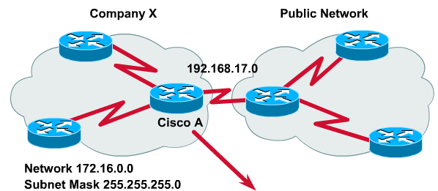
OSPF, propagating a default route
!Configure a gateway of last resort
Router(config)#ip route 0.0.0.0 0.0.0.0 [interface | next-hop address]
! To propagate this route to all the routers in a normal OSPF area
Router(config-router)#default-information originate
Notes:
OSPF routing ensures loop-free paths to every network in the domain. To reach networks outside the domain, either OSPF must know about the network or OSPF must have a default route. To have an entry for every network in the world would require enormous resources for each router. A practical alternative is to add a default route to the OSPF router connected to the outside network. This route can be redistributed to each router in the AS through normal OSPF updates.
A configured default route is used by a router to generate a gateway of last resort. The static default route configuration syntax uses the network 0.0.0.0 address and a subnet mask 0.0.0.0:
Router(config)#ip route 0.0.0.0 0.0.0.0 [interface | next-hop address]
This is referred to as the quad-zero route, and any network address is matched using the following rule. The network gateway is determined by ANDing the packet destination with the subnet mask.
The following configuration statement will propagate this route to all the routers in a normal OSPF area:
Router(config-router)#default-information originate
All routers in the OSPF area will learn a default route provided that the interface of the border router to the default gateway is active.

Slide 67
Common OSPF configuration issues
Failure to establish a neighbor relationship is caused by any of the following reasons:
  Hellos are not sent from both neighbors.
  Hello and dead interval timers are not the same.
  Interfaces are on different network types.
  Authentication passwords or keys are different.
In OSPF routing it is also important to ensure the following:
  All interfaces have the correct addresses and subnet mask.
  network area statements have the correct wildcard masks.
  network area statements put interfaces into the correct area.
Notes:
An OSPF router must establish a neighbor or adjacency relationship with another OSPF router to exchange routing information. Failure to establish a neighbor relationship is caused by any of the following reasons:
Hellos are not sent from both neighbors.
Hello and dead interval timers are not the same.
Interfaces are on different network types.
Authentication passwords or keys are different.
In OSPF routing it is also important to ensure the following:
All interfaces have the correct addresses and subnet mask.
network area statements have the correct wildcard masks.
network area statements put interfaces into the correct area.

Slide 68
Verifying OSPF Operation
Router#
show ip protocols
Verifies that OSPF is configured
Router#
show ip route
Displays all the routes learned by the router
Router#
show ip ospf interface
Displays area ID and adjacency information
Notes:
© 2003, The SaigonCTT – A Regional Cisco Networking Academy
CNAP Semester <x> – <Chapter name>
<Chapter> - <number>

Slide 69
Verifying OSPF Operation (cont.)
Router#
show ip ospf
Displays OSPF timers and statistics
Displays information about DR, BDR and neighbors
Displays the link-state database
Router#
show ip ospf neighbor detail
Router#
show ip ospf database
Notes:
© 2003, The SaigonCTT – A Regional Cisco Networking Academy
CNAP Semester <x> – <Chapter name>
<Chapter> - <number>

Slide 70
Verifying OSPF Operation (cont.)
Router#
clear ip route *
Allows you to clear the IP routing table
Router#
debug ip ospf option
Displays router interaction during the hello, exchange, and flooding processes
Notes:
© 2003, The SaigonCTT – A Regional Cisco Networking Academy
CNAP Semester <x> – <Chapter name>
<Chapter> - <number>

Slide 71
show ip ospf interface
R2#sh ip ospf int e0
Ethernet0 is up, line protocol is up
Internet Address 192.168.0.12/24, Area 0
Process ID 1, Router ID 192.168.0.12, Network Type BROADCAST, Cost: 10
Transmit Delay is 1 sec, State DROTHER, Priority 1
Designated Router (ID) 192.168.0.11, Interface address 192.168.0.11
Backup Designated router (ID) 192.168.0.13, Interface address 192.168.0.13
Timer intervals configured, Hello 10, Dead 40, Wait 40, Retransmit 5
Hello due in 00:00:04
Neighbor Count is 3, Adjacent neighbor count is 2
Adjacent with neighbor 192.168.0.13 (Backup Designated Router)
Adjacent with neighbor 192.168.0.11 (Designated Router)
Suppress hello for 0 neighbor(s)
Notes:
© 2003, The SaigonCTT – A Regional Cisco Networking Academy
CNAP Semester <x> – <Chapter name>
<Chapter> - <number>

Slide 72
show ip ospf neighbor
Neighbor ID Pri State Dead Time Address Interface
192.168.0.13 1 2WAY/DROTHER 00:00:31 192.168.0.13 Ethernet0
192.168.0.14 1 FULL/BDR 00:00:38 192.168.0.14 Ethernet0
192.168.0.11 1 2WAY/DROTHER 00:00:36 192.168.0.11 Ethernet0
192.168.0.12 1 FULL/DR 00:00:38 192.168.0.12 Ethernet0
OSPF over Ethernet - Multiaccess Network
Neighbor ID Pri State Dead Time Address Interface
192.168.0.11 1 FULL/ - 00:00:39 10.1.1.2 Serial1
OSPF over HDLC - Point-to-Point Network
Notes:
© 2003, The SaigonCTT – A Regional Cisco Networking Academy
CNAP Semester <x> – <Chapter name>
<Chapter> - <number>

Slide 73
show ip ospf database
R2#show ip ospf database
OSPF Router with ID (192.168.0.12) (Process ID 1)
Router Link States (Area 0)
Link ID ADV Router Age Seq# Checksum Link count
192.168.0.10 192.168.0.10 817 0x80000003 0xFF56 1
192.168.0.11 192.168.0.11 817 0x80000003 0xFD55 1
192.168.0.12 192.168.0.12 816 0x80000003 0xFB54 1
192.168.0.13 192.168.0.13 816 0x80000003 0xF953 1
192.168.0.14 192.168.0.14 817 0x80000003 0xD990 1
Net Link States (Area 0)
Link ID ADV Router Age Seq# Checksum
192.168.0.14 192.168.0.14 812 0x80000002 0x4AC8
Notes:
© 2003, The SaigonCTT – A Regional Cisco Networking Academy
CNAP Semester <x> – <Chapter name>
<Chapter> - <number>

Slide 74
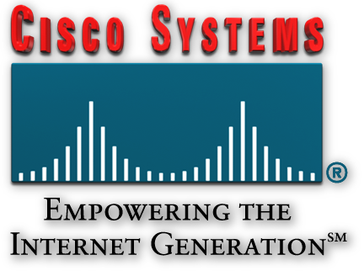
Summary
Link-state routing protocols collect routing information from all other router in the network or within a defined area of the network. Link-state routing protocols perform the following functions:
  Respond quickly to network changes
  Send triggered update only when a network change has occurred
  Send periodic updates know as link-state refreshes
  Use a hello mechanism to determine the reachability of neighbors
OSPF is link-state routing protocol based on open standards.
OSPF routing uses the concept of area. Each router contains a complete database of link-states in specific area

Slide 75

Q&A
Notes:
_________________________________________________________________________
_________________________________________________________________________
_________________________________________________________________________
_________________________________________________________________________
_________________________________________________________________________
_________________________________________________________________________
_________________________________________________________________________
_________________________________________________________________________
_________________________________________________________________________
_________________________________________________________________________
_________________________________________________________________________
_________________________________________________________________________
_________________________________________________________________________
_________________________________________________________________________
_________________________________________________________________________
_________________________________________________________________________
_________________________________________________________________________
_________________________________________________________________________
_________________________________________________________________________

Slide 76
Enjoy the Course
Notes:
_________________________________________________________________________
_________________________________________________________________________
_________________________________________________________________________
_________________________________________________________________________
_________________________________________________________________________
_________________________________________________________________________
_________________________________________________________________________
_________________________________________________________________________
_________________________________________________________________________
_________________________________________________________________________
_________________________________________________________________________
_________________________________________________________________________
_________________________________________________________________________
_________________________________________________________________________
_________________________________________________________________________
_________________________________________________________________________
_________________________________________________________________________
_________________________________________________________________________
_________________________________________________________________________

